Slide 1
Parking spot indicator
PIP104 University Project
Review-1
Batch Number:01
Roll Number | Student Name
Under the Supervision of,
Ms. YOGEETHA B R
School of Computer Science & Engineering
Presidency University
20201COD0015 G.CHETAN REDDY
20201C0D0035 T.NARENDRA
20201COD0031 G.SANDEEP REDDY
20201COD0012 HARI TEJA AV
20201C0D0040 SHAIK ARSHAD

Slide 2
Introduction
India is indeed one of the world's largest automobile markets, and its rapid economic growth has led to a significant increase in the number of vehicles on its roads. However, the country faces a considerable challenge in providing sufficient parking space for this ever-growing number of vehicles. This shortage of parking spots has led to several issues, including traffic congestion and improper parking situations.
The increasing number of vehicles in India has created a dire need for innovative solutions to address the parking problem. One of the potential solutions to this issue is the development and implementation of a low-cost connected ecosystem that can help individuals find the nearest available parking spot when needed. This technology can have several advantages and implications

Slide 3
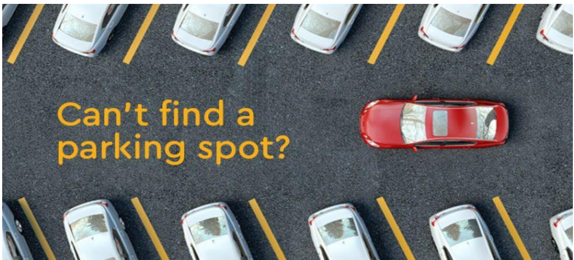
Literature Review
In recent years, India has encountered a pressing issue: a severe lack of adequate parking spaces. With the number of motor cars exceeding each passing day, the country’s current parking situation falls severely short of meeting expectations. According to an IBM study, drivers in Delhi spend an average of 19 minutes looking for a parking spot, with the situation being considerably worse in Mumbai and Bengaluru

Slide 4
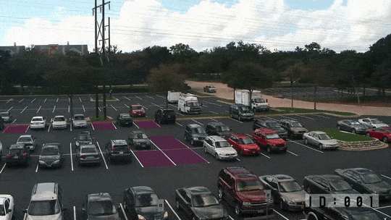
Proposed Method
The field of artificial intelligence (AI) has emerged as a game changer in addressing this issue by providing drivers with real-time information on parking availability, shaping the future of parking

Slide 5
Objectives
Following are some of our objectives:
1. Training the machine learning model
2. Developing an interactive front end
3.Preparing back end to store data.
4. The interactions between the user and the website should be fast.
5. Store User related details such as Name, Phone number, Account ID.

Slide 6
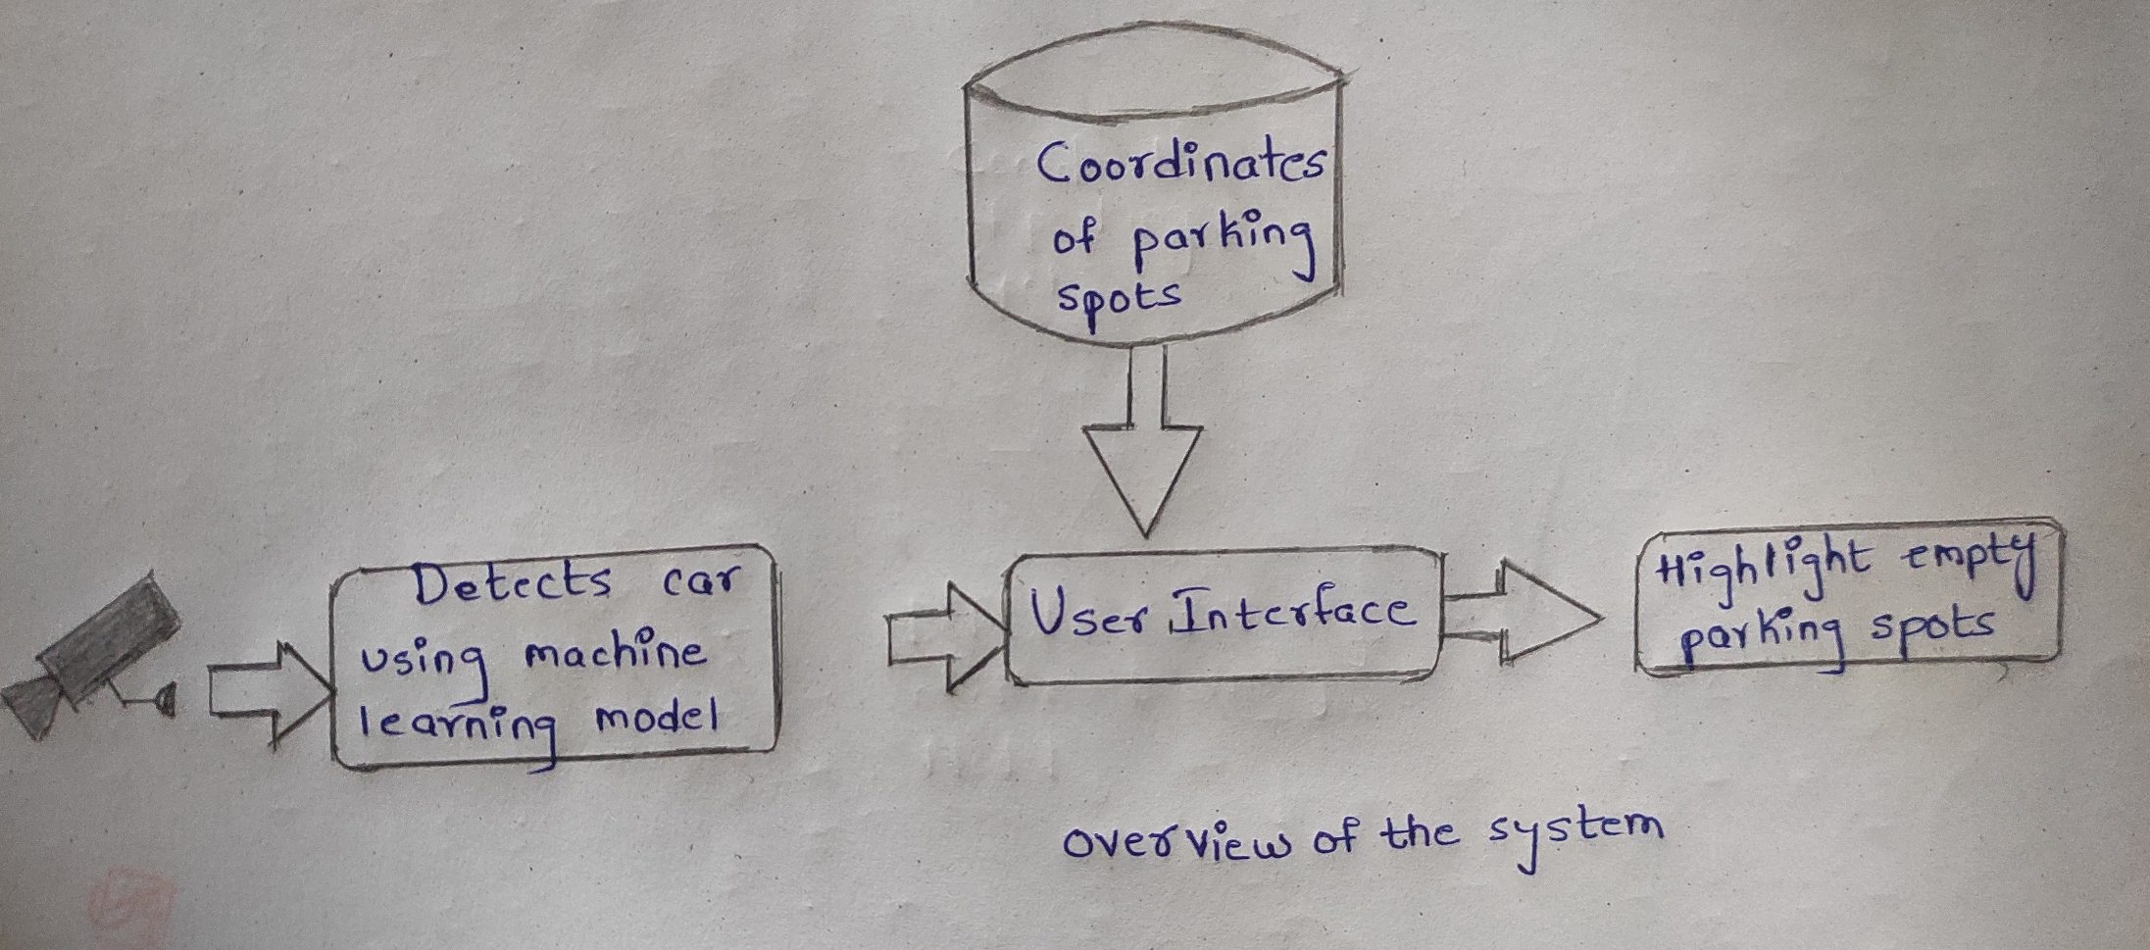
Methodology

Slide 7
Timeline of Project
Review-0 →13-Oct-2023→ PROJECT OVERVIEW
Review-1→10-Nov-2023 →DEVELOPING FRONT END PART
Review-2 →30-Nov-2023 →TRAINING AND TESTING THE MACHINE LEARNING MODEL
Review-3→30-Dec-2023→DEVELOPING THE BACK END PART AND
INTIGRATING ALL THE COMPONENTS

Slide 8
Expected Outcomes
The slot detector component utilizes computer vision techniques to identify available parking slots in a given video feed. It processes the video frames, applies image processing algorithms, and detects the occupancy status of parking slots. It provides accurate and real-time information on available and occupied slots.
The slot finder component offers a user-friendly interface for defining and managing parking slots. It allows users to mark parking slots in a given image or video frame manually. Users can add new slots, remove existing slots, and update slot positions as needed. The slot finder facilitates the customization and adaptation of the system to different parking lot layouts.
The web-based dashboard provides a convenient and interactive way to visualize the parking slot status. It displays real-time information on available slots, used slots, and total slots. Users can access the dashboard through a web browser and monitor the parking situation remotely. The dashboard also includes login and registration functionality for user authentication and access control.

Slide 9
Conclusion
In conclusion, addressing the parking issue in India is critical, given the ever-increasing number of vehicles. Implementing a low-cost connected ecosystem that combines artificial intelligence, real-time data, and user-friendly interfaces can greatly improve the parking situation. By utilizing technology and user-friendly tools, it's possible to alleviate traffic congestion, reduce time wasted searching for parking, and enhance the overall experience for drivers in India's crowded urban areas.

Slide 10
References
AI Can Detect Open Parking Spaces
A STUDY ON SMART PARKING MANAGEMENT SYSTEM IN INDIA
Smart Car Parking System

Slide 11
Thank You

